Slide 1
Microservices
Presented by:
Sphoorthi Poojary
Shishir Kulkarni
Shubham Pachpute
Under the guidance of:
Prof. Tanuja Phadke

Slide 2

Monolith vs Microservices

Slide 3
Monolith vs Microservices
 | Monolith | Microservice
Architecture | Built as a single logical executable | Built as a suite of small services, each running separately and communicating with lightweight mechanisms
Modularity | Based on language features | Based on business capabilities
Agility | Changes to the system involve building and deploying a new version of the entire application | Changes can be applied to each service independently
Implementation | Typically written in one language | Each service implemented according to need
Maintainability | Large code base intimidating to new developers | Smaller code base easier to manage

Slide 4

Microservices vs SOA
Confused ???

Slide 5
Microservices vs SOA
 | SOA | Microservice
Scope | Services are built around business processes. So no definite scope for services | One functionality per service strictly. Eg Auth.
Service Types | Distinguished as Functional and infrastructural | Business, Enterprise, Application and infrastructural and many more...
Components | Share as much as possible. Could lead to tight coupling. | Share as little as possible. Bound context. Eg Each service has access to relevent databases only.
Orchestration and Choreography | Orchestration. One centralized controller (Mule, Camel, Spring Integration etc.) | Choreography. Coordination without a coordinator.
Which to use when | Very large scope, Enterprise wide application or if app. 0could resuse services | Small web applications, Workflow applications. Discrete scoped applications.

Slide 6
Sync and Async model
Synchronous – The client expects a timely response from the service and might even block while it waits.
Asynchronous – The client doesn’t block while waiting for a response, and the response, if any, isn’t necessarily sent immediately.

Slide 7
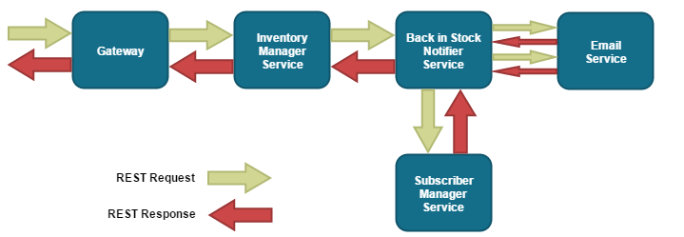
Sync model
the update stock operation will not return until the notification service
has completed its task of notifying all relevant customers.

Slide 8
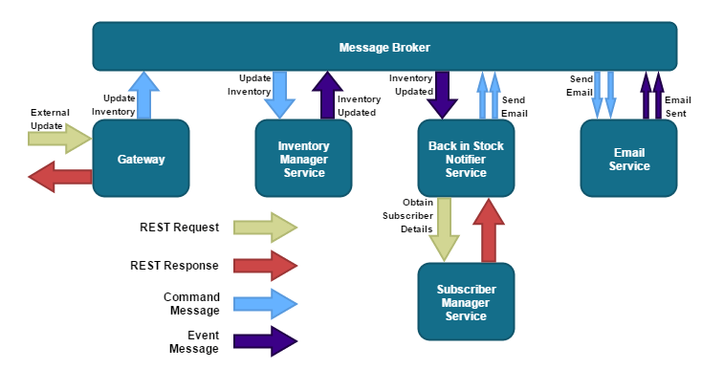
Async model
The Inventory Manager has a single responsibility,
not affected by failure of Back in Stock Notifier service

Slide 9
Communication in Microservices
Communication can be classified into :
Synchronous OR Asynchronous
Single receiver OR multiple receiver

Slide 10
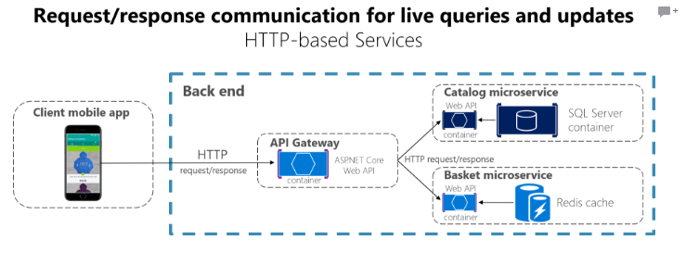
Synchronous Communication
When a client uses request/response communication, it sends a request to a service, then the service processes the request and sends back a response.

Slide 11
Asynchronous Communication
Lightweight message broker
Use asynchronous message : between internal services
Synchronous messaging – between client apps and front end services

Slide 12
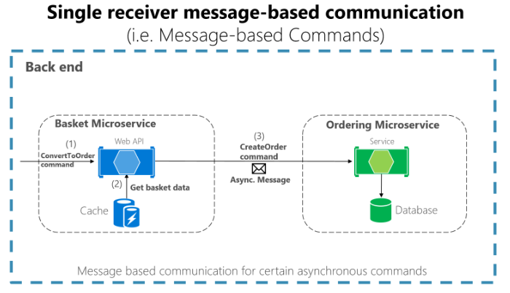
Single receiver & Multiple receiver asynchronous
Single receiver asynchronous
Multiple receiver asynchronous : Publish subscribe model

Slide 13
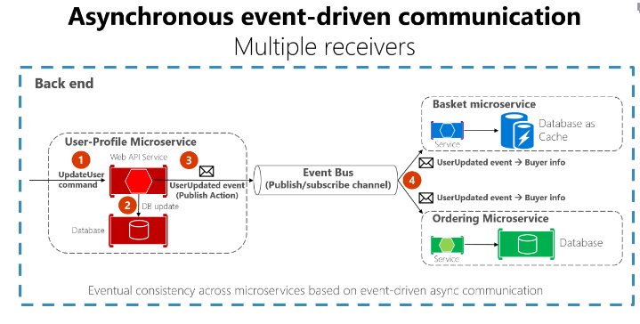
Asynchronous event driven

Slide 14
Scaling
Qualitative Growth Scaling
Quantitave Growth Scaling
Phrase the growth scale in terms of requests per second(RPS) – Microservices queries per second (QPS) – databases
The importance of choosing accurate qualitative and quantitative growth scales cannot be overemphasized

Slide 15
Any Questions? Thank You!!!

